Slide 1
Data Structures
Stack

Slide 2
Stack data structure
Stack data structure is like a container with a single opening.
  Can only access element at the top
  Add/insert new items at the top
  Remove/delete an item from the top
Stack in real life:
  collection of elements arranged in a linear order.
    - stack of books, stack of plates, stack of chairs.

Slide 3
Stack
push
pop
A stack is open at one end (the top) only. You can push entry onto the top, or pop the top entry out of the stack.
Note that you cannot add/extract entry in the middle of the stack.
top
C
B
A
bottom

Slide 4
Last-in First-out (LIFO)
A
B
C
C
Insert(A);
Insert(B);
Insert(C);
Remove();
Remove();
Remove();
The last one inserted in is the first one removed out! (LIFO)
B
C
B
A
A
A
B
C
When we insert entries onto the stack and then remove them out one by one, we will get the entries in reverse order.
B
A
A

Slide 5
Abstract Data Type ADT
A data type whose properties (domain and operations) are specified independently of any particular implementation
ADT is a mathematical model which gives a set of utilities available to the user but never states the details of its implementation.
In OO-Programming a Class is an ADT

Slide 6
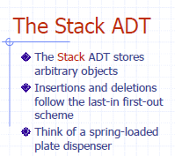
Dr. Kazi A. Kalpoma

Slide 7
Stack Operations
Push(X) – insert element X at the top of the stack and increment the top index.
Pop() – remove the element from the top of the stack with/without returning element and decrement the top index.
Top() – return the top element without removing it from the stack. top index does not change.

Slide 8
stack implementation by an array
#define stack_size 6;
int top;
char stack[stack_size];
?
5 (stacksize-1)
?
4
?
3
?
2
?
1
?
0
stack
top = 2
stack

Slide 9
Initialization of top index of Stack
stack_initialize()
{
top = -1;
}
?
5 (stacksize-1)
?
4
?
3
?
2
?
1
?
0
top
E--1ntry
top = 0
It can be initialize in different way too, Suppose
top = 0;

Slide 10
Push(X)
Before insertion it needs first to check the overflow situation i.e. stack is full or not full
void push(char X)
{
if(top >= stack_size-1)
cout<<“Overflow: stack is full”;
else
{
top++; /increase top by 1
stack[top] = X; /insert the item on top
}
}
?
5 (stacksize-1)
?
4
?
3
?
2
?
1
top= 0 →1
top
X
0
entry
if(top> stack_size-1)
cout <<”overflow: stack is full”;
else
{stack[top] = X;
top++;
top++;
stack[top] = X;
Stack[++top] = X;

Slide 11
Pop()
void pop() //pop function is not returning
{
if(top<0)
cout<<"underflow: stack is empty”;
else
{
char X = stack[top];
top--;
}
}
Before deletion it needs first to check the underflow situation i.e. stack is empty or not empty
?
5
?
4
?
3
?
2
?
1
?
0
top
E--1ntry
entry
top= 1→0
if(top==0)
cout <<"underflow: stack is empty”;
else
{char X = stack[top];
top--;

Slide 12
Pop() //pop function is returning the top element
char pop()
{
if(top<0)
cout<<"underflow: stack is empty”;
else
{
char X = stack[top];
top--;
return X;
}
}
?
5
?
4
?
3
?
2
?
1
?
0
top
E--1ntry
entry
top= 1→0

Slide 13
Top()
char Top() //top function is returning top value
{
return stack[top]; //but not reduce top index
}
?
5
?
4
?
3
?
2
top= 1→0
top
R
1
K
0
entry
Char Top() //top function is returning top value
{
return stack[top-1]; //but not reduce top index
}

Slide 14
Other operations
int IsEmpty()
{
return ( top < 0 );
}
int IsFull()
{
return ( top >= stack_size-1);
}
?
5 (stacksize-1)
?
4
?
3
?
2
?
1
?
0
stack
top = 2
int IsEmpty()
{
return ( top == 0 );
}
int IsFull()
{
return ( top > stack_size-1);
}

Slide 15
// ……Program for stack implementation
#include <iostream>
using namespace std;
// here add all the initializations and
//functions’ definitions of stack.
int main()
{
push(9);
push(7);
push (8);
push (4);
pop ( );
push (5);
pop ( );
pop ( );
cout<< " top element of stack is = " << top() << endl;
bout << " top index is = " << top << endl;
}
?
5 (stacksize-1)
?
4
4
3
8
2
7
1
9
0
stack
top = 2

Slide 16
// ……Program for stack implementation
#include <iostream>
using namespace std;
// here add all the initializations and
//functions’ definitions of stack.
int main()
{
push(9);
push(7);
push (8);
push (4);
pop ( );
push (5);
pop ( );
pop ( );
cout<< " top element of stack is = " << top() << endl;
bout << " top index is = " << top << endl;
}
?
5 (stacksize-1)
?
4
?
3
8
2
7
1
9
0
stack
top = 2

Slide 17
// ……Program for stack implementation
#include <iostream>
using namespace std;
// here add all the initializations and
//functions’ definitions of stack.
int main()
{
push(9);
push(7);
push (8);
push (4);
pop ( );
push (5);
pop ( );
pop ( );
cout<< " top element of stack is = " << top() << endl;
bout << " top index is = " << top << endl;
}
?
5 (stacksize-1)
?
4
5
3
8
2
7
1
9
0
stack
top = 2

Slide 18
// ……Program for stack implementation
#include <iostream>
using namespace std;
// here add all the initializations and
//functions’ definitions of stack.
int main()
{
push(9);
push(7);
push (8);
push (4);
pop ( );
push (5);
pop ( );
pop ( );
cout<< " top element of stack is = " << top() << endl;
bout << " top index is = " << top << endl;
}
?
5 (stacksize-1)
?
4
3
2
7
1
9
0
stack
top = 2
top element of stack is = 7
top index is = 1

Slide 19
// ……Program for stack implementation using stack class
#include <iostream>
#include <stack>
using namespace std;
int main()
{ stack <int> st;
st.push(9);
st.push(7);
st.push (8);
st.push (9);
st.pop ( );
st.push (5);
st.pop ( );
st.pop ( );
cout<< " top element of stack is = " << st.top() << endl;
bout << " top index is = " << st.size()-1 << endl;
}
top element of stack is = 7
top index is = 1

Slide 20
Traversing a stack
void show()
{
int i;
for(i=top; i>=0; i--)
cout<< “ “<<stack[i];
}
OUTPUT:
D C B A
?
?
top
D
3
C
2
B
1
A
0
Stack[ ]

Slide 21
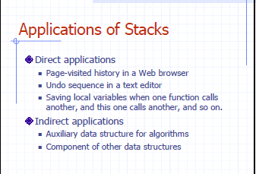
Dr. Kazi A. Kalpoma

Slide 22
Application of stack continuation……
Syntax parsing, Expression evaluation and Expression conversion.
Banking Transaction View
    - You view the last transaction first.
Backtracking and implementation of recursive function, calling function.
Towers of Hanoi
Inventory Systems like Issuing students the Multi-meters… you will be issued the most recently returned item likely

Slide 23
Validity checking of an arithmetic expression
When there is a opening parenthesis; brace or bracket, there should be the corresponding closing parenthesis. Otherwise, the expression is not a valid one. We can check this validity using stack.
Dr. Kazi A. Kalpoma

Slide 24
Stack in Problem Solving
Consider a mathematical expression that includes several sets of nested parenthesis, e.g
( x + (y – (a +b)) )
We want to ensure that parenthesis are nested correctly and the expression is valid
Validation
  There is an equal number of closing and opening parentheses
  Every closing parenthesis is preceded by a matching opening parenthesis

Slide 25
Algorithm
Whenever an opening is encountered, PUSH() on to stack
Whenever a closing is encountered,
  If stack is empty, expression is invalid.
  If stack is nonempty, POP() the stack and check with corresponding closing parenthesis. If match occurs continue. Otherwise expression is invalid.
When the end of expression is reached, stack must be empty; otherwise expression invalid.

Slide 26
Example:
[(A+B)-{(C+D)-E}]
Symbol | Stack
[ | [
( | [(
A | [(
+ | [(
B | [(
) | [
- | [
{ | [{
( | [{(
C | [{(
+ | [{(
D | [{(
) | [{
- | [{
E | [{
} | [
]

Slide 27
Algebraic Expression
An algebraic expression is a legal combination of operands and the operators.
Operand is the quantity (unit of data) on which a mathematical operation is performed.
Operand may be a variable like x, y, z or a constant like 5, 4,0,9,1 etc.
Operator is a symbol which signifies a mathematical or logical operation between the operands. Example of familiar operators include +,-,*, /, ^ , %
Considering these definitions of operands and operators now we can write an example of expression as
x+y*z

Slide 28
Infix, Postfix and Prefix Expressions
INFIX: From our schools times we have been familiar with the expressions in which operands surround the operator, e.g. x+y, 6*3 etc this way of writing the Expressions is called infix notation.
POSTFIX: Postfix notation are also Known as Reverse Polish Notation (RPN). They are different from the infix and prefix notations in the sense that in the postfix notation, operator comes after the operands, e.g. xy+, xyz+* etc.
PREFIX: Prefix notation also Known as Polish notation. In the prefix notation, as the name only suggests, operator comes before the operands, e.g. +xy, *+xyz etc.

Slide 29
Operator Priorities
How do you figure out the operands of an operator?
  a + b * c
  a * b + c / d
This is done by assigning operator priorities.
  priority(*) = priority(/) > priority(+) = priority(-)
When an operand lies between two operators, the operand associates with the operator that has higher priority.

Slide 30
Tie Breaker
When an operand lies between two operators that have the same priority, the operand associates with the operator on the left.
  a * b / c / d
  Delimiters
Sub expression within delimiters is treated as a single operand, independent from the remainder of the expression.
  (a + b) * (c – d) / (e – f)

Slide 31
WHY PREFIX and POSTFIX ?
Why to use these weird looking PREFIX and POSTFIX notations when we have simple INFIX notation?
To our surprise INFIX notations are not as simple as they seem specially while evaluating them. To evaluate an infix expression we need to consider Operators’ Priority and Associative property
  For example expression 3+5*4 evaluate to 32 i.e. (3+5)*4 or to 23 i.e. 3+(5*4).
To solve this problem Precedence or Priority of the operators were defined. Operator precedence governs evaluation order. An operator with higher precedence is applied before an operator with lower precedence.

Slide 32
Infix Expression Is Hard To Parse
Need operator priorities, tie breaker, and delimiters.
This makes computer evaluation more difficult than is necessary.
Postfix and prefix expression forms do not rely on operator priorities, a tie breaker, or delimiters.
So it is easier to evaluate expressions that are in these forms.

Slide 33
Both prefix and postfix notations have an advantage over infix that while evaluating an expression in prefix or postfix form we need not consider the Priority and Associative property (order of brackets).
  E.g. x/y*z becomes
  */xyz in prefix and
  xy/z* in postfix.
Both prefix and postfix notations make Expression Evaluation a lot easier.

Slide 34
When do we need to use them… ☺
So, what is actually done in expression is scanned from user in infix form; it is converted into prefix or postfix form and then evaluated without considering the parenthesis and priority of the operators.

Slide 35
Algorithm for Infix to Postfix conversion
1) Examine the i^{th} element in the input, infix[i].
2) If it is operand, output it at k^{th} location (pop to postfix[k]).
3) else If it is opening parenthesis ‘(’, push it on stack.
4) else If it is a closing parenthesis ‘)’,
pop (operators) from stack and output to postfix[k] them until an opening parenthesis ‘(’ is encountered in the top of stack.
pop and discard the opening parenthesis ‘(’ from stack.
5) else If it is an operator ‘+’, ‘-’, ‘*’, ‘/’, ‘%’ then
  i) If stack is empty, push operator on stack.
  ii) else If the top of stack is opening parenthesis ‘(’, push on stack
  iii) else If it has higher priority than the top of stack, push on stack.
  iv) else pop the operator from the stack and output it, repeat step 5
6) If there is more input in infix[], go to step 1
7) If there is no more input, pop the remaining operators to output.

Slide 36
Suppose we want to convert infix: 2*3/(2-1)+5*3 into Postfix form,
Input (infix) | Stack | Output (Postfix)
2 | Empty | 2
* | * | 2
3 | * | 23
/ | / | 23*
( | /( | 23*
2 | /( | 23*2
- | /(- | 23*2
1 | /(- | 23*21
) | / | 23*21-
+ | + | 23*21-/
5 | + | 23*21-/5
* | +* | 23*21-/53
3 | +* | 23*21-/53
 | Empty | 23*21-/53*+
So, the Postfix Expression is 23*21-/53*+

Slide 37
Example
( 5 + 6) * 9 +3
will be
5 6 + 9 * 3 +
Conversion of infix to prefix: try it at home.

Slide 38
Evaluating Postfix Notation
Use a stack to evaluate an expression in postfix notation.
The postfix expression to be evaluated is scanned from left to right.
Variables or constants are pushed onto the stack.
When an operator is encountered, the indicated action is performed using the top elements of the stack, and the result replaces the operands on the stack.

Slide 39
Algorithm: To evaluate a postfix value
Add “)” at the right end of the expression.
Scan p from left to right and repeat step 3 and 4 for each element of p until encountered “)”.
If an operand is encountered, PUSH it in stack.
If an operator  is encountered, then
  To remove two element from stack Call POP() twice and first POP() put to A and second one to B.
  Evaluate C = B  A.
  PUSH(C) in stack.
Set the value = POP(), the top element of stack.
Exit

Slide 40
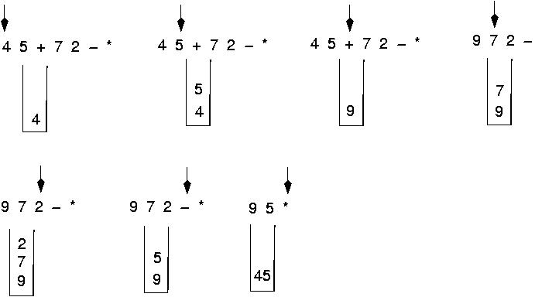
Postfix expressions:
Algorithm using stacks (cont.)

Slide 41
Question : Evaluate the following expression in postfix :
623+-382/+*2^3+
Final answer is ?
49
51
52
7
None of these

Slide 42
Evaluate- 623+-382/+*2^3+ )
6
2
6
3
2
6
623+-382/+*2^3+)
65-382/+*2^3+) 1382/+*2^3+)
5
6
1
3
1
8
3
1
2
8
3
1
4
3
1

Slide 43
Cont. of Evaluation- 623+-382/+*2^3+
134+*2^3+)
72^3+) 493+) )
= 52
4
3
1
7
1
7
2
7
49
3
49
52

Slide 44
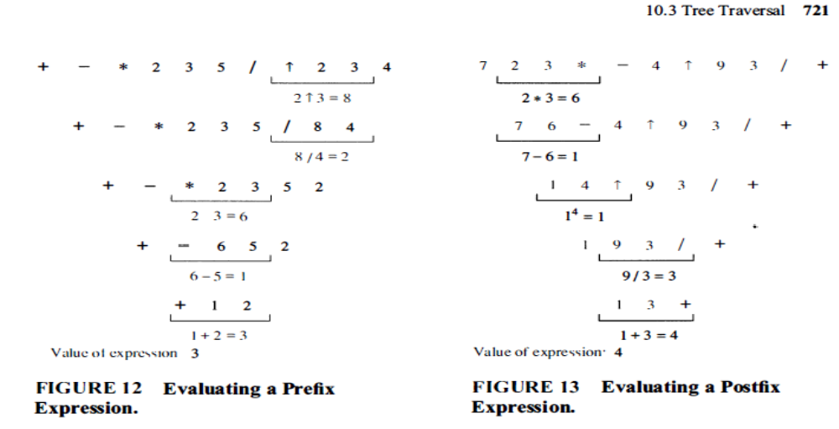

Slide 45
Algorithm: To evaluate a prefix value
Add “(” at the left end of the expression.
Scan p from right to left and repeat step 3 and 4 for each element of p until encountered “(”.
If an operand is encountered, PUSH it in stack.
If an operator  is encountered, then
  To remove two element from stack Call POP() twice and first POP() put to A and second one to B.
  Evaluate C = A  B
  PUSH(C) in stack.
Set the value = POP(), the top element of stack.
Exit

